Slide 1
IT FDN120 A Su Foundations of Algorithms and Data Structure Final Presentation – Decision Tree
By Hiroyuki Takechi

Slide 2
Why Decision Trees?
Decision tree is one of the best supervised learning methods for the classification.
The key goal of the decision tree is to identify the association between features (predictor variable) and target variable by following the decision tree rules.
Pros:
Flexibility: handles both categorical and continuous numerical variables as well as linear and non-linear data.
Transparency: Uses white-box approach so that the rules and outputs are relatively transparent to the analytics consumers, comparing to the black box approach such as artificial neural network.
Cons:
Overfitting: When the tree grows, it causes overfitting issue which means that train model only works on the train data.
Implementation: Decision Tree algorithm is too complex to implement manually but fortunately, Python and R provides the modules for the decision tree modeling.

Slide 3
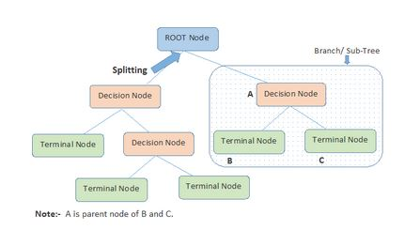
What is Decision Trees?
Basically it is similar to the binary tree that the class covers. The tree grows by the rule below:
Node:
Root Node: Starting point
Decision Node: When a sub-node splits into further sub-nodes, then it is called decision node
Leaf/Terminal Node: Nodes with no split.
Process:
Splitting: Diving a node into two or more sub-nodes
Pruning: Removing sub-nodes of a decision node.
https://www.analyticsvidhya.com/blog/2016/04/complete-tutorial-tree-based-modeling-scratch-in-python/

Slide 4
Case Study 1/3 - Dataset
Data: Customer purchase history for an insurance product
Goal: Identify features that influence their buy decision of an insurance product
Tool: R and rpart package (I couldn’t install Scipy and SkLearn on PyCharm…)
Data Description:
Target: Buy_Insurance variable (YES or NO)
Feature: 30 predictor variables
R Code:
customers = read.csv("C:/Users/hirotak/Desktop/R/sample_customers.csv") #dim(customers) #head(customers) summary(customers)

Slide 5
Case Study 2/3 – Decision Tree Modeling
The decision tree model identified the four key features associated with the target variable:
Bank_FUNDS
CHECKING_AMOUNT
MONEY_MONTHLY_OVERDRAWN
CREDIT_BALANCE
R Code:
#install.packages("rpart") library(rpart) model = rpart(BUY_INSURANCE ~ ., data = customers[,-1:-7], control = rpart.control(maxdepth = 4)); model #cleaner model

Slide 6
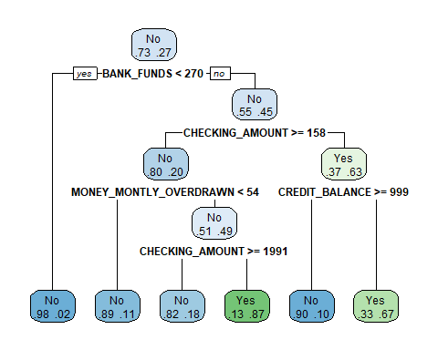
Case Study 3/3 – Visualization
R Code:
#install.packages("rpart.plot") library(rpart.plot) rpart.plot(model, extra = 4)

Slide 7
Conclusion
In Summary….
Decision Tree is relatively easy for the audience to comprehend the output as long as the tree is small and balanced.
Manual implementation is very hard but fortunately, modules and packages are available for some programming languages such as Python and R.
Decision Tree is more flexible than other association models but it comes with the weakness of possible overfitting when the tree grows.

Slide 8
Reference
https://www.analyticsvidhya.com/blog/2016/04/complete-tutorial-tree-based-modeling-scratch-in-python/
http://qiita.com/nkjm/items/e751e49c7d2c619cbeab
http://scikit-learn.org/stable/modules/tree.html

